Slide 1
Installing Operating System

Slide 2

What is an Operating System?
Operating System is a software, which makes a computer to actually work.
It is the software the enables all the programs we use.
The Operating System organizes and controls the hardware.
Operating System acts as an interface between the application programs and the machine hardware.

Slide 3
Basic tasks of OS.
Controlling and allocating memory.
Prioritizing system requests,
Controlling input and output devices.
Facilitate networking.
Managing file systems.

Slide 4
Main functions of OS.
* The main functions of operating systems are:
Program creation.
Program execution.
Input/output operations.
Error detection.
Resource allocation.
Accounting.

Slide 5
Types of OS.
Single User Systems.
Provides a platform for only one user at a time.
They are popularly associated with Desk Top operating system which run on standard systems where no user accounts are required.
Example: DOS.

Slide 6
Multi User Systems.
Provides regulate access for a number of users by maintaining a database of known users.
Refers to computer systems that support two or more simulation users.
Another term for multi-user is time sharing.
Example: Unix.

Slide 7

Compare between Operating Systems.

Slide 8
Windows
There are has many viruses.
Is less expensive than MAC.
MAC
There are no viruses.
Too much expensive.
Linux
There are lesser viruses.
Software is totally free.
All of software are compatible with Windows.
Many of software are not compatible with MAC.
Is open source software.
Is reliable but due to viruses.
Not reliable because in not a complete OS you can modify it for that type of use you want.
Too much reliable and smooth because it has no viruses..

Slide 9
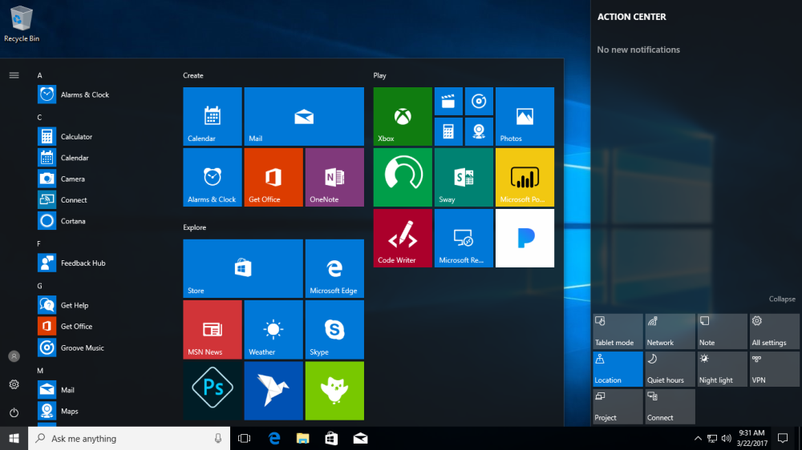
What is Microsoft Windows?
Microsoft Windows is a family of proprietary operating systems designed by Microsoft Corporation and primarily targeted to Intel architecture based computers, Windows versions date back to September 1981.

Slide 10
Types of Microsoft Windows.
1- Windows XP it was released on October
25, 2001.
2- Windows Vista it was released on November
30, 2006.
3- Windows 7 it Was released on October
22, 2009.
4- Windows 8 it was released on October
26, 2012.
5- Windows 8.1 it was released on August
27, 2013.
6- Windows 10 it was released on July
29, 2015.

Slide 11

Advantages of Microsoft Windows.
Ease to use.
Available Software.
Multi-Tasking.
Support for new hardware.
Games.

Slide 12

Disadvantages of Microsoft Windows.
Closed Source.
Poor security.
Viruses.
Poor technical support.
Poor remote access.

Slide 13
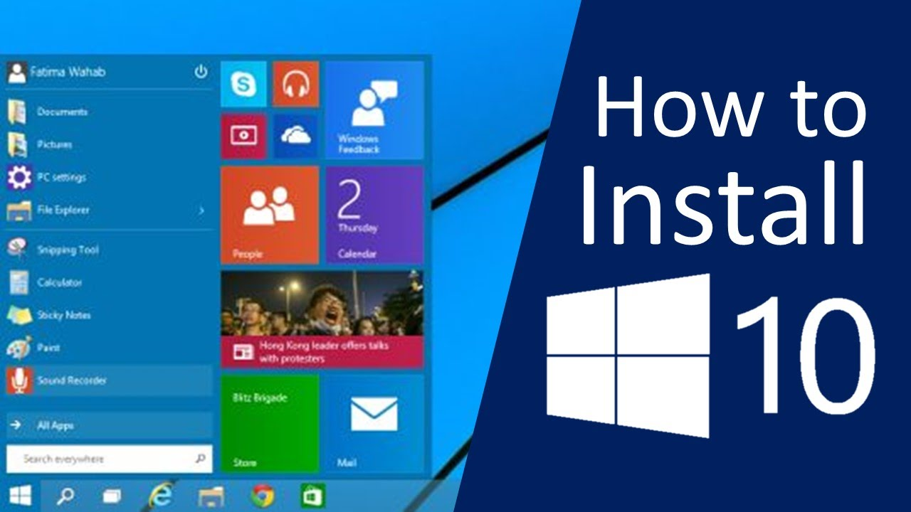
Steps for installing Microsoft Windows.

Slide 14
You can use Microsoft’s upgrade tool to install Windows 10 on your PC if you already have Windows 7 or 8.1 installed. This will also make it possible to downgrade and go back to Windows 7 or 8.1 after you perform the upgrade, if you don’t like it.

Slide 15
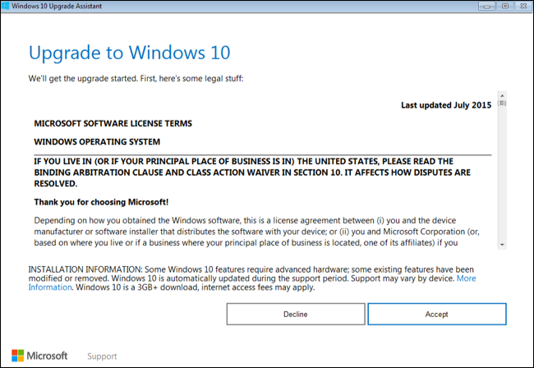

Slide 16
If you don’t want to upgrade from an existing Windows installation, you can download the official Windows 10 installation media for free from Microsoft and perform a clean install.

Slide 17
To do this, visit Microsoft’s Download Windows 10 page, click “Download Tool Now”, and run the downloaded file. Select “Create installation media for another PC”.

Slide 18
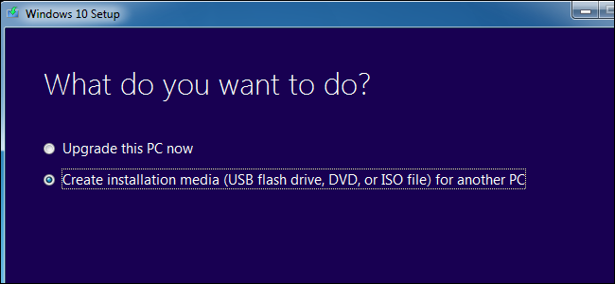

Slide 19
Be sure to select the language, edition, and architecture you want to install of Windows 10. If you’re installing it on a PC with a 64-bit CPU, you probably want the 64-bit version. If you’re installing it on a PC with a 32-bit CPU, you’ll need the 32-bit version.

Slide 20
You can check what type of CPU your PC has if you don’t know off the top of your head.

Slide 21
If you’re installing Windows 10 on the current PC, just keep the “Use the recommended options for this PC” box checked and the tool will automatically download the correct version for your current PC.

Slide 22
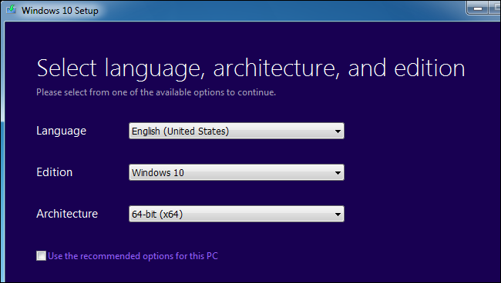

Slide 23
The tool will allow you to copy the Windows 10 installation files to a USB drive or burn them to a DVD. If you’re using a USB drive, it must be 4 GB or larger in size. All files on the USB drive will be erased as part of this process.

Slide 24
If you want to install Windows 10 in a virtual machine, select the “ISO file” option here. The tool will download an ISO file, and you can then boot the downloaded ISO in a virtual machine to install Windows 10 inside it

Slide 25
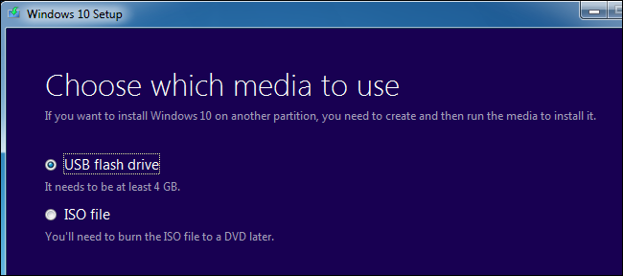

Slide 26
Once you’ve created installation media, you’ll need to insert it into the PC you want to install Windows 10 on. You then boot from the installation media. This may require modifying the boot order in your PC’s BIOS or UEFI firmware.

Slide 27


Slide 28
On the Windows Setup screen, select your language, time and currency format, and keyboard layout. Click “Next” to continue.

Slide 29
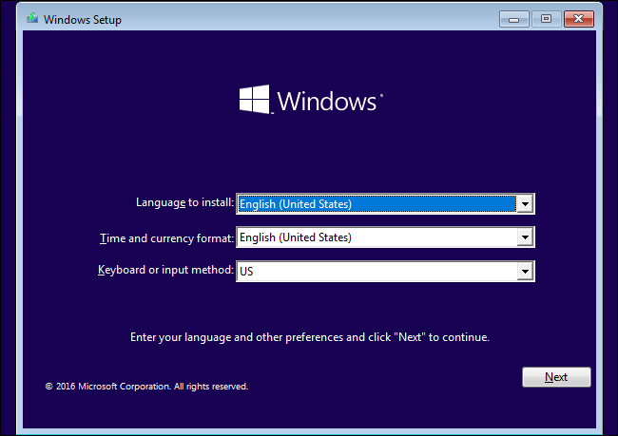

Slide 30
When you reach the installer screen, select “Install Now” and follow the instructions to install Windows 10 on your PC.

Slide 31
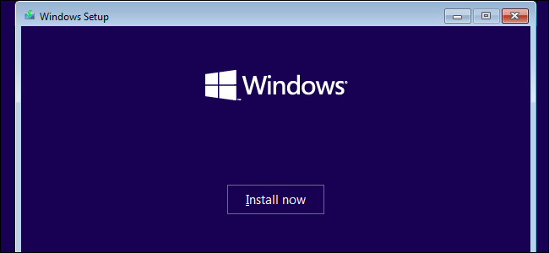

Slide 32
When you see the Activate Windows screen, you’ll need to either enter a key or skip it. You may not see this screen if Windows 10 automatically detects a key associated with your PC’s hardware.

Slide 33
If you’ve never installed and activated Windows 10 on this computer before, enter your Windows 10 key here. If you don’t have one, but you have a valid Windows 7, 8, or 8.1 key, enter it here instead.

Slide 34
If you’ve previously taken advantage of the free Windows 10 upgrade offer on this PC, click “I don’t have a product key”. Windows will automatically activate with a “digital license” associated with your PC’s hardware on Microsoft’s servers once it’s installed.

Slide 35
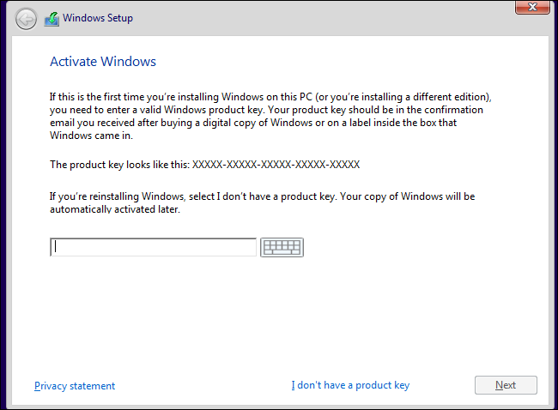

Slide 36
When you reach the “Which type of installation do you want?” screen, click “Custom” to perform a clean installation and remove everything on your PC. (If you’ve changed your mind and want to upgrade your existing installation, you can click “Upgrade”.)

Slide 37
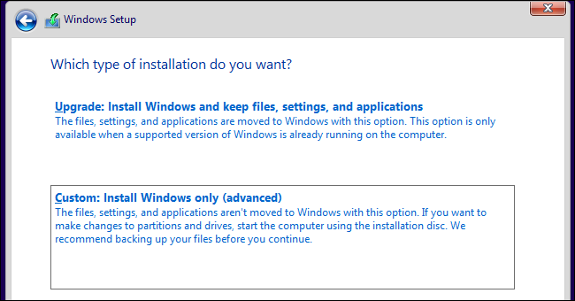

Slide 38
On the next screen, select the hard drive you want to install Windows on and erase it. If you have multiple partitions on that drive, you may want to erase those as well.

Slide 39
Warning: When you delete a partition, you’re also deleting all the files on that partition. Be sure you have backups of any important files before doing this!

Slide 40
When you’re done erasing partitions, you should have a big block of “Unallocated Space”. Select that, click “New”, and once it’s formatted your drive, click Next.

Slide 41
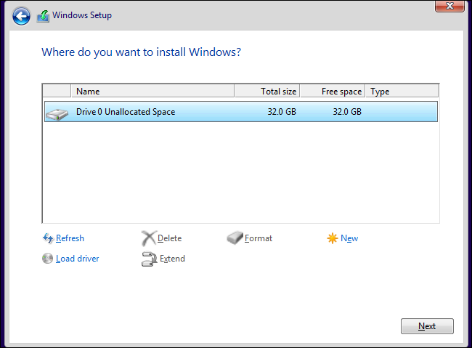

Slide 42
Windows 10 will install itself, and may restart a few times during this process. When it’s done, you’ll see the normal setup interface you see when setting up Windows 10 on any new PC, where you can add user accounts and adjust various settings.

Slide 43
